Slide 1
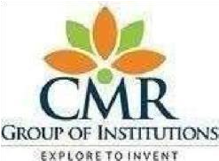
DEPARTMENT OF COMPUTER SCIENCE AND ENGINEERING CMR TECHNICAL CAMPUS 2019-2023 A Major Project on UNDERWATER IMAGE COLOR CORRECTION AND CONTRAST ENHANCEMENT BASED ON HUE PRESERVATION
Under the Guidance of
J.Narasimha Rao
(Associate Professor)
Presented by-
Bhupathiraju Geetha Supriya (197R1A05J9)
Yogitha Potlapally (197R1A05Q0)
Katepogu Stephen Kumar (177R1A05F1)

Slide 2
ABSTRACT:
Underwater Image suffers from serious color distortion and low contrast problems because of complex light propagation in the ocean. In view of computing constraints of underwater vehicles, we propose a high-efficiency deep-learning based framework based on hue preservation.
The framework contains three convolutional neural networks for underwater image color restoration. At first, we use the first CNN to convert the input underwater image into the grayscale image. Next, we enhanced the grayscale underwater image by the second CNN. And then, we perform the color correction to the input underwater image by the third CNN. At last, we can obtain the color-corrected image by integrating the outputs of three CNNs based on the hue preservation.
We use the unsupervised learning method CycleGAN to train the underwater CNNs. This training method may let the three CNNs of our proposed framework support each other to avoid the training overfitting and without constraint.

Slide 3
EXISTING SYSTEM:
Underwater optical imaging systems mainly include an optical camera, or adopt techniques such as polarization, stereo/panoramic, and spectral imaging. However, each of techniques other than optical cameras has its limitations, such as a narrow field of view, limited depth, complex and professional operation, etc.
There are several techniques which are used very frequently for processing the image to improve the visual quality. Some of them are Contrast Stretching and Adaptive Histogram Equalization.

Slide 4

DISADVANTAGES:
In Contrast Stretching disadvantage is that the transformation function is not unique. Depending on the application the suitable transformation function is chosen.
In Adaptive Histogram Equalization technique highlights the unwanted noise present in the background of an image and lead to loss in the information signal. It results in undesired effects in the resultant images.

Slide 5
PROPOSED SYSTEM:
The proposed deep learning-based underwater image restoration framework consists of the four stages:
the underwater image grayscale stage relying on CNN to convert the underwater image to the best gray-channel image
(2) the grayscale underwater image details enhancement stage also relying on CNN to remove the noise and enhance the image quality
(3) the underwater image color restoration stage via end-to-end CNN and
(4) the generation stage of the final high image quality and correct color underwater image by integrating the outputs of the other three stages. The details of the four stage is in the following four subsection, respectively.

Slide 6

ADVANTAGES:
Remove the noise in underwater environment and reserve the detail that may affect by CNN, we propose a grayscale detail enhancement CNN.
Our experimental results show that the proposed method achieve better underwater image restoration performance than other methods.
Greater Efficiency.

Slide 7



HARDWARE AND SOFTWARE REQUIREMENTS:
Processor - Intel Core i5 and above
Speed - 2.5 GHz RAM - 8 GB (min)
Hard Disk - 50 GB
OS version - 5.0 and above
Operating System - Windows 10 Programming
MATLAB

Slide 8
NOVELTY
In this study, a novel underwater color image enhancement based on hue preserving is presented by combining hue saturation intensity and HS value color models.The degraded image is first converted from re-green-blue color model into the HSI color model, wherein the hue component H is preserved. In addition, experimental results show that the proposed approach outperformes several other state of the art algorithms.

Slide 9
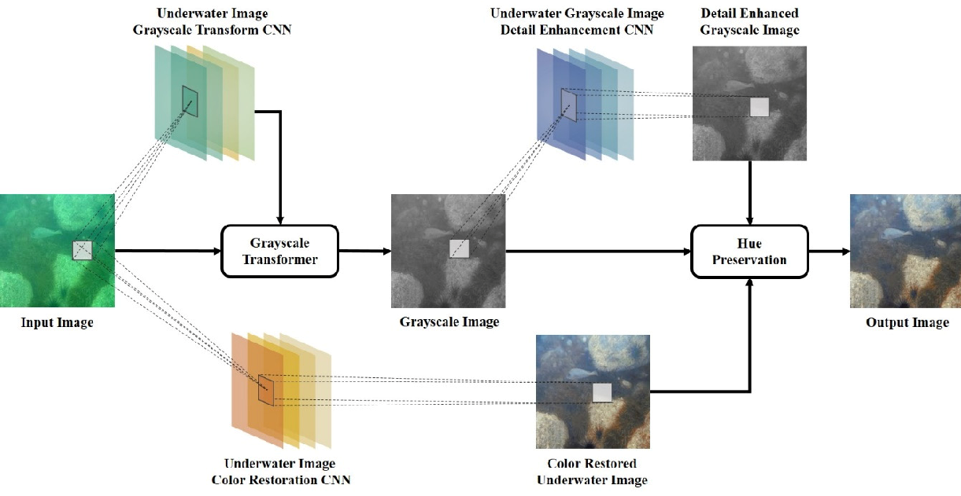
ARCHITECTURE

Slide 10
MODULE
Convolutional Neural Networks (CNN):
Three layers of convolutional neural networks are used to
Colour Correction Model:
Colour correction model is used to overcome the low contrast that made an image blur.
Underwater Restoration Algorithm:
The aim of underwater restoration algorithms is to recover the lost colors of an image by reducing blur and blaze.

Slide 11
UML DIAGRAMS:
Use case Diagram
Class Diagram
Sequence Diagram

Slide 12
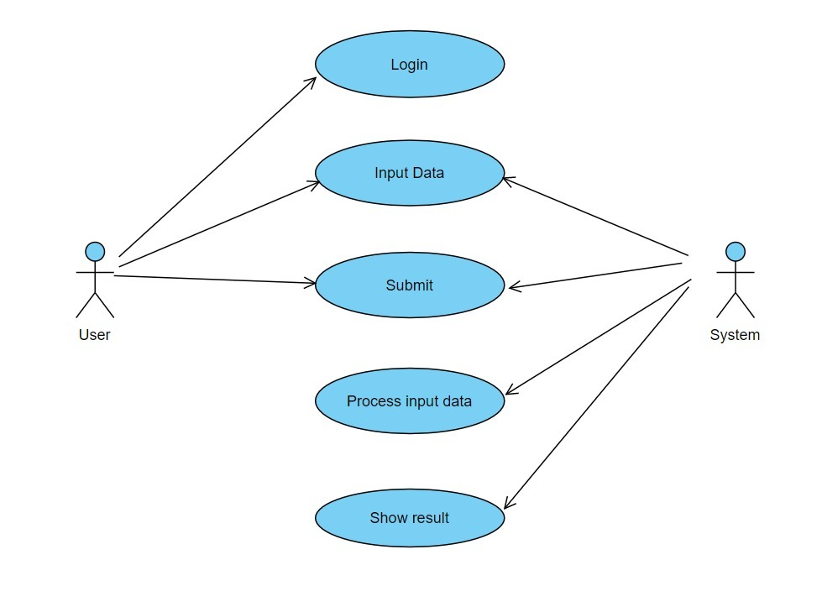
Use Case Diagram:

Slide 13
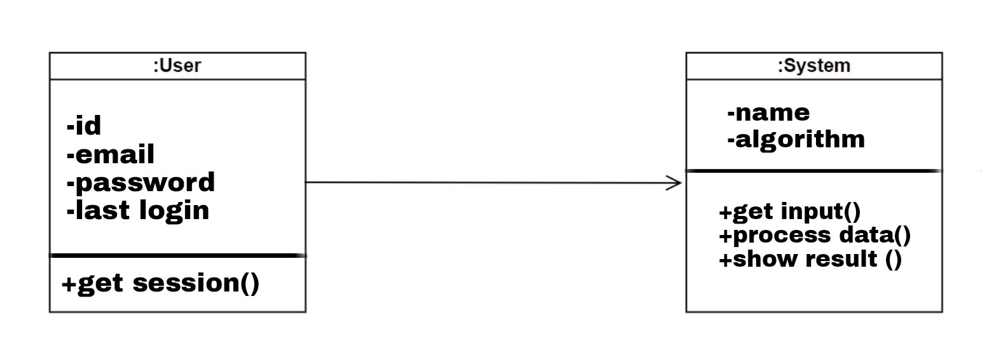
Class Diagram:

Slide 14
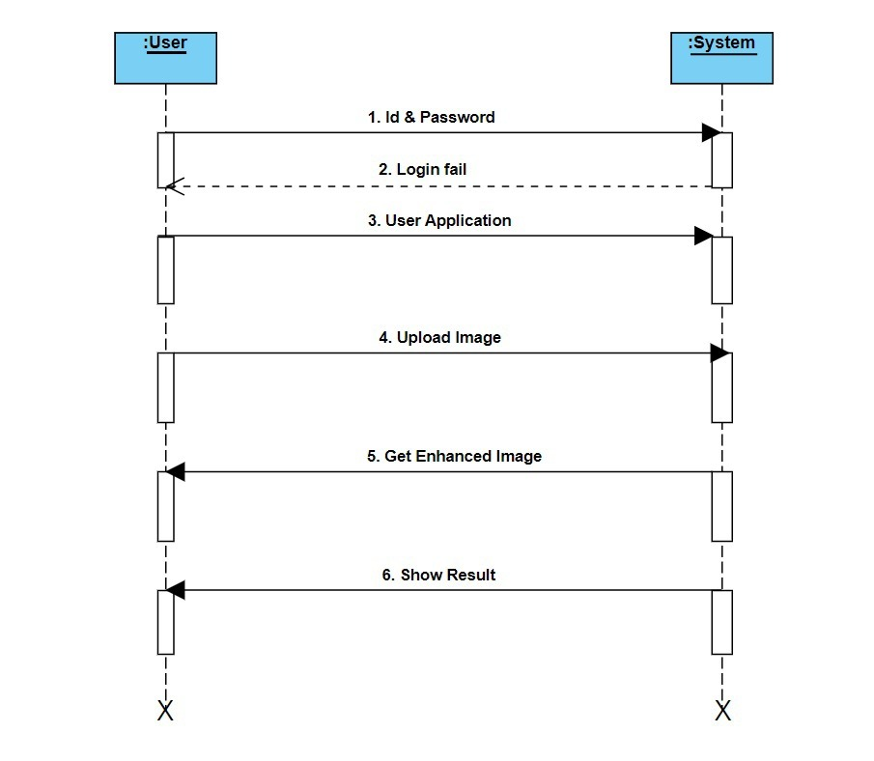
Sequence Diagram:

Slide 15
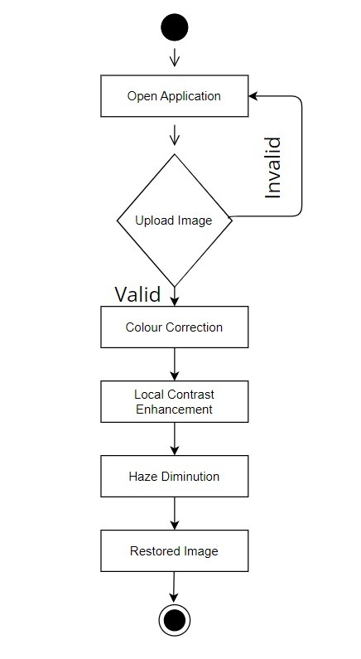
Activity Diagram:

Slide 16
SAMPLE CODE
clc;
close all;
clear all;
warning off
%%%%%under water image enhncement
%%%%%%%%%%%%%%%% Image Aquisition %%%%%%%%%%%%%%%%%%%%%%%%%%%
[filename, pathname] = uigetfile({'*.jpg';'*.png'}, 'pick an image');
if isequal(filename, 0) || isequal(pathname, 0)
helpdlg('Image input canceled.');
else
X=imread(fullfile(pathname, filename));
end

Slide 17
figure,imshow(X);title('original image');
%%%%%%%%%%%%devide color space images
N = 256;
A = im2uint8(X);
a=rgb2hsv(X);
fig = figure;
subplot(2,2,1);
imshow(A);
title('original image');
ColorList = { 'Red' 'Green' 'Blue' };
gr = 0:1/(N-1):1;
for k = 1:3
% color map:
cMap = zeros(N,3);
cMap(:,k) = gr;
subplot(2,2,k+1);
imshow(ind2rgb(A(:,:,k),cMap));

Slide 18
title(ColorList{k});
end
%%% bidirectional Empirical Mode Decomposition (BEMD) analysis
normal_thr_limit=0.5;
low_limt=0.002;
up_limit=0.999;
%----------------------------------------------------------------------
under_image=X;
[CONTRAST saliency chromatic]=size(X);
%----------------------------------------------------------------------

Slide 19
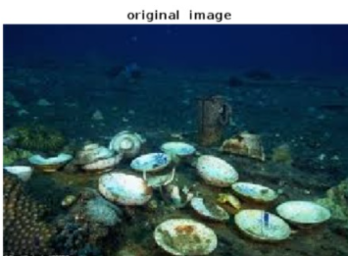
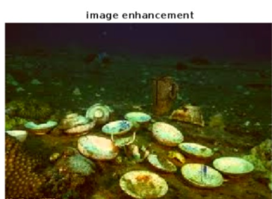
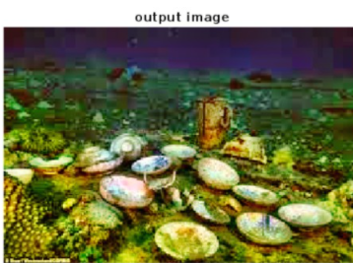
RESULTS

Slide 20
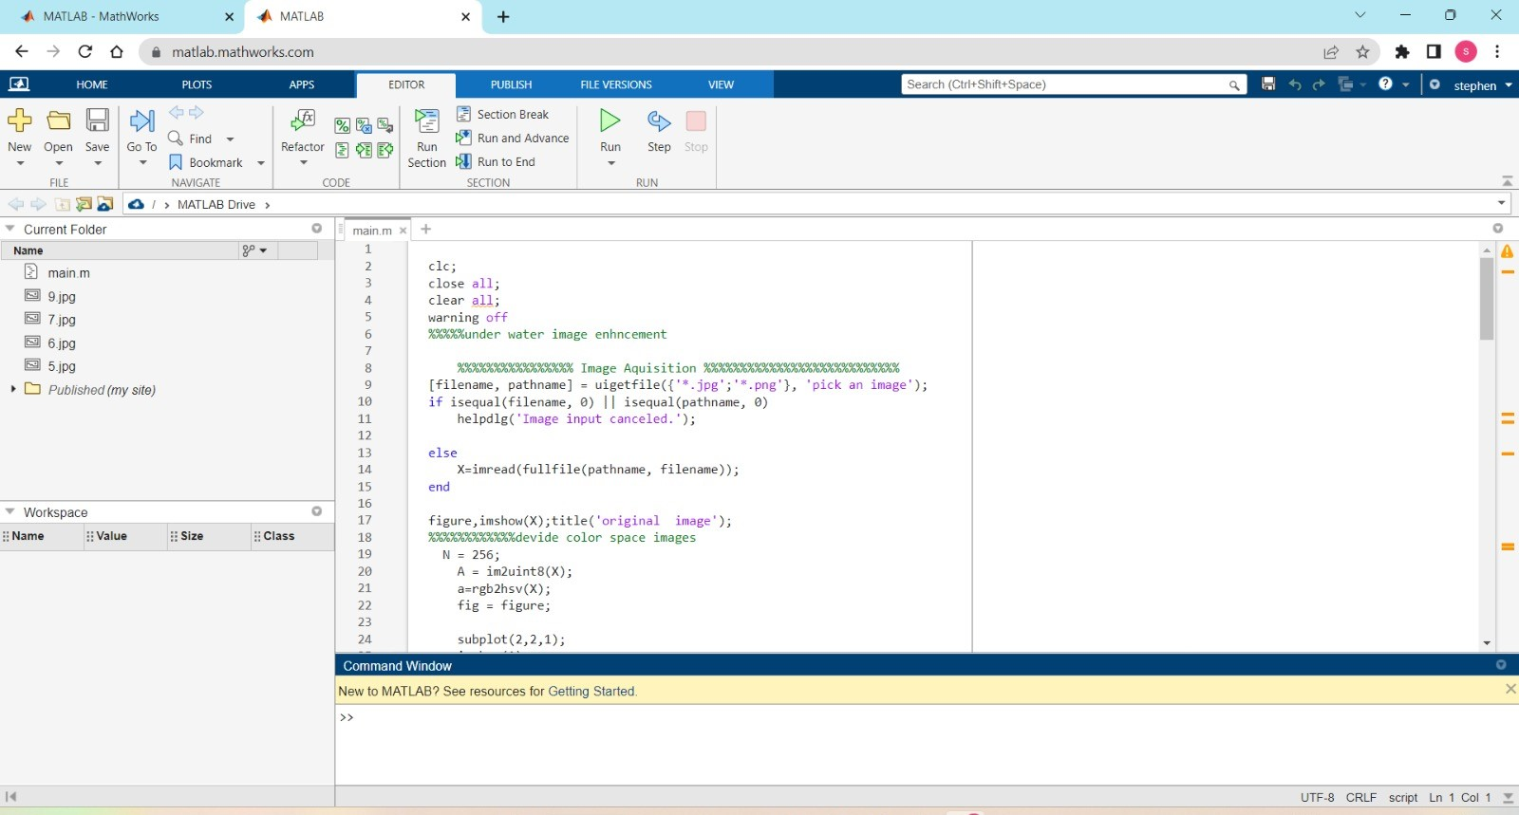
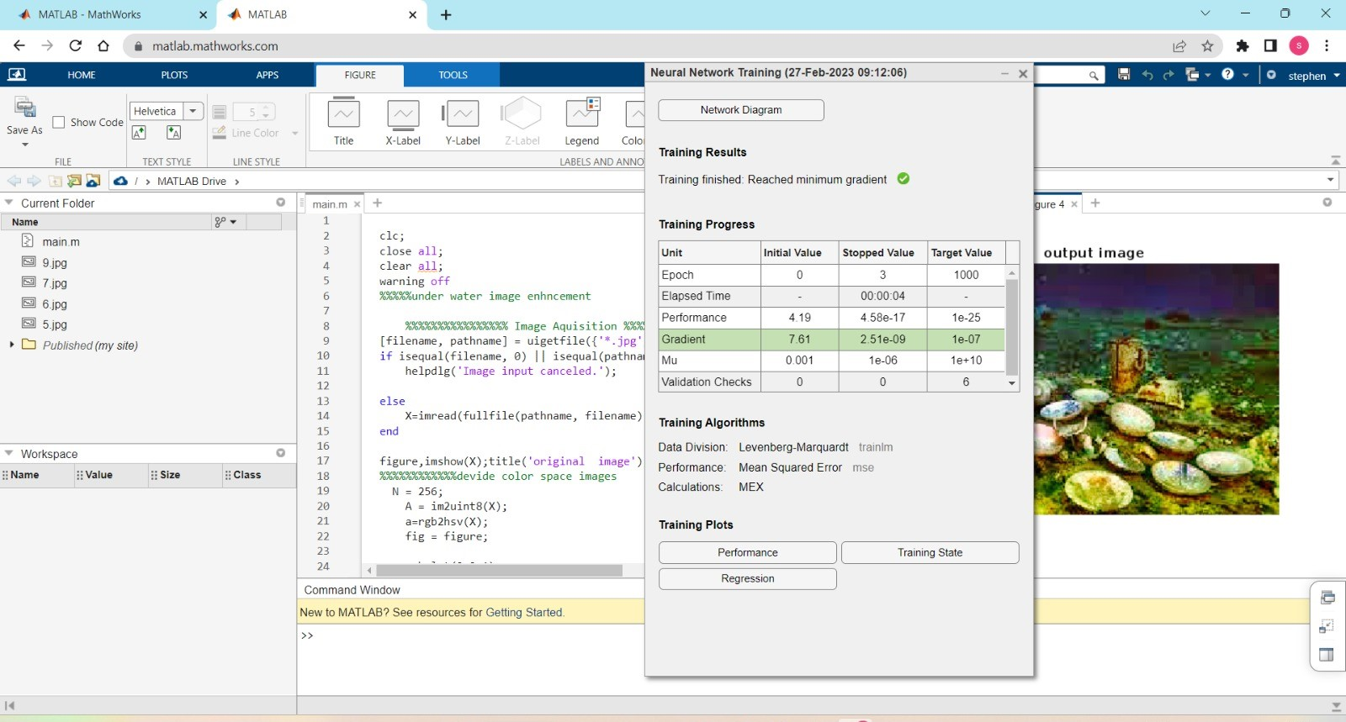
SCREENSHOTS

Slide 21
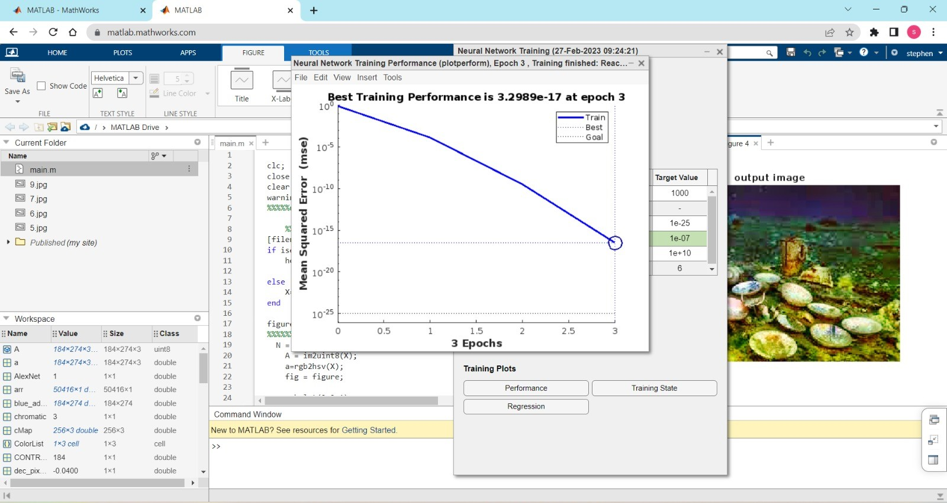
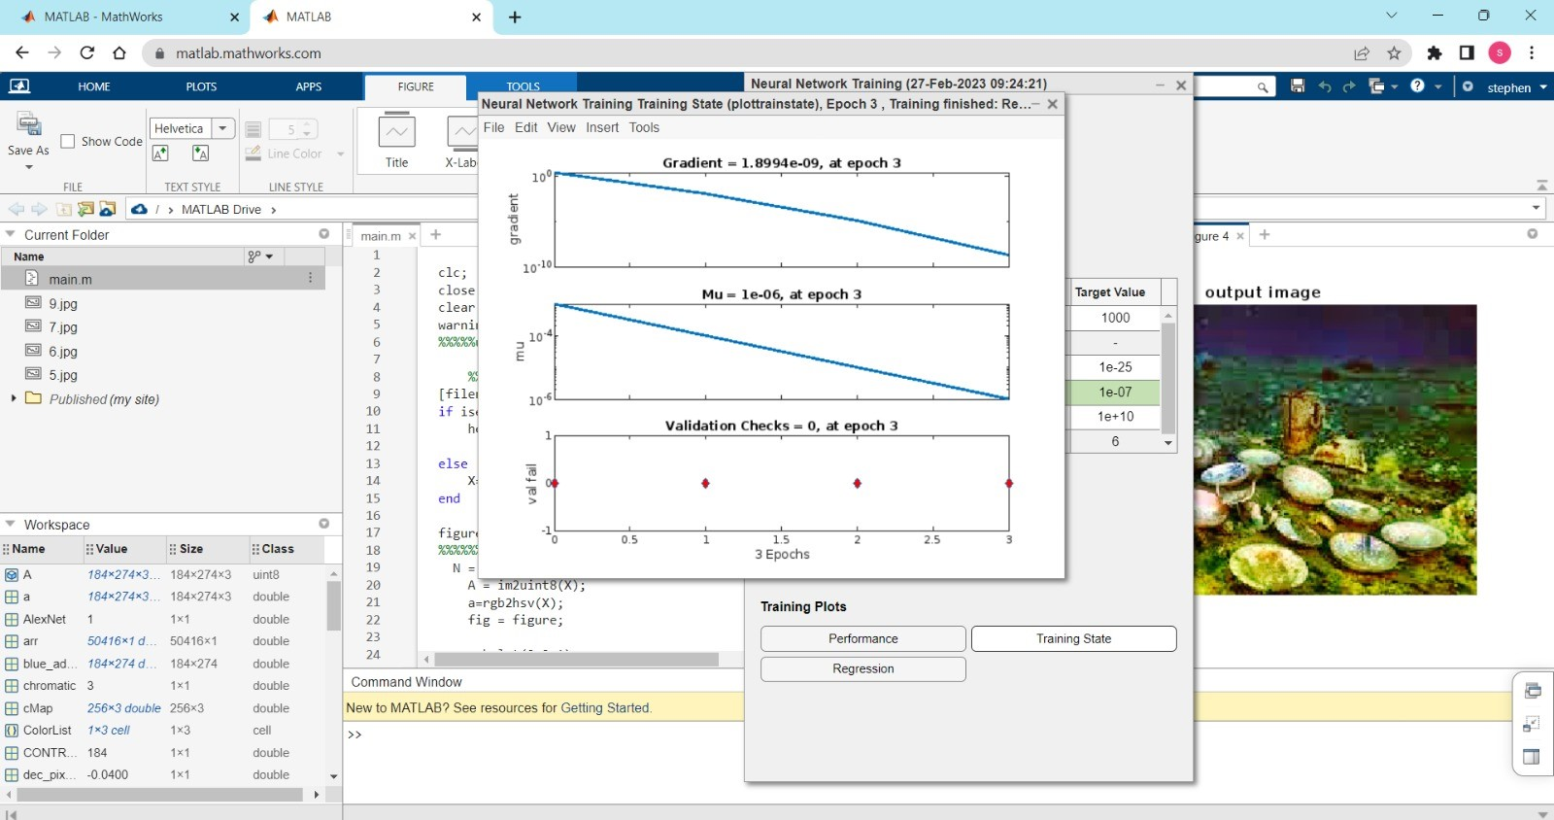
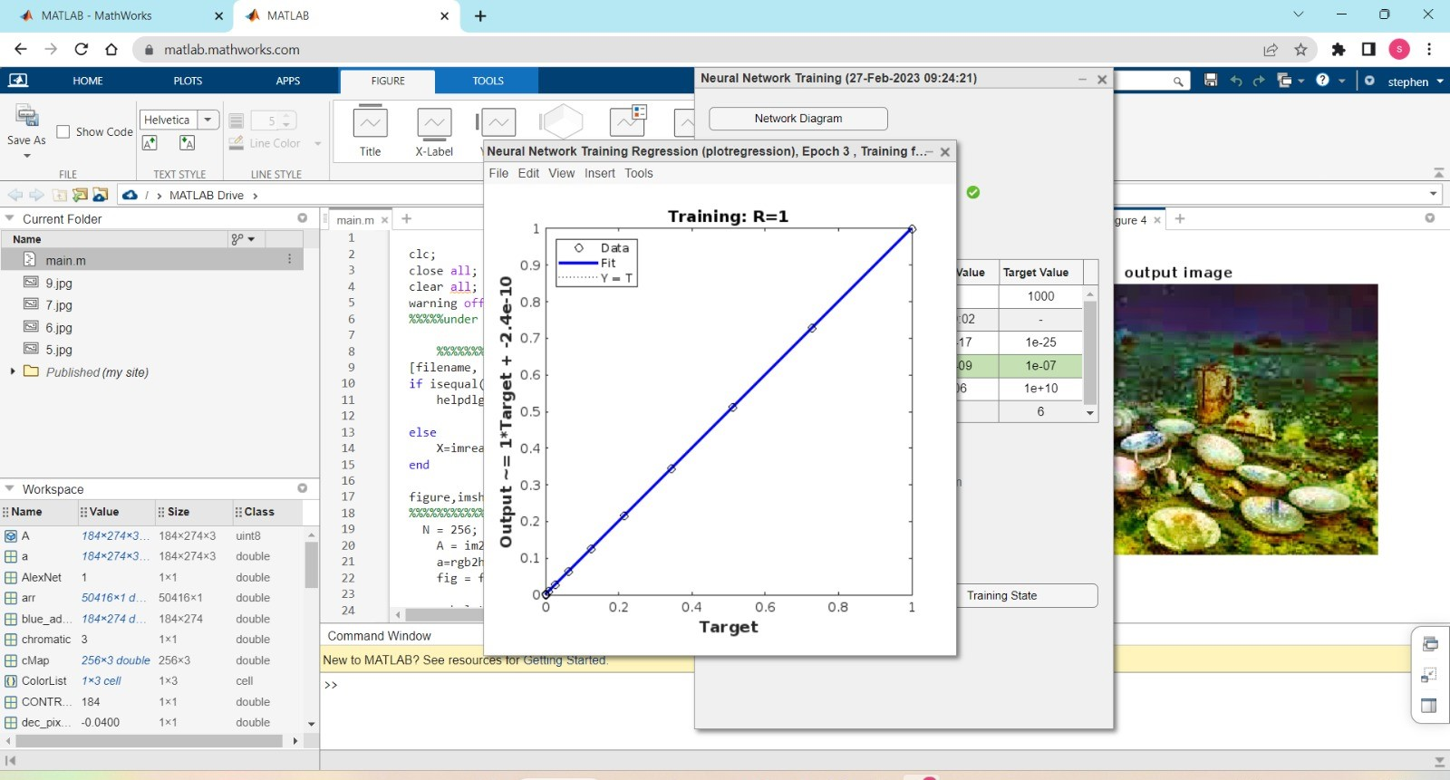

Slide 22
CONCLUSION:
In this paper, we propose a CNN framework for underwater image color restoration. Our method converts an input underwater image to the grayscale image by using CNN to estimate the grayscale coefficients. We also use CNN to restore the color of the input underwater image. To remove the noise in underwater environment and reserve the detail that may affect by CNN, we propose a grayscale detail enhancement CNN. At last, we integrate all works by the hue preservation enhancement. Our experimental results show that the proposed method achieve better underwater image restoration performance than other methods.

Slide 23
FUTURE ENHANCEMENT
The potential idea behind the idea of the project is the additional feature, we aim to leverage the pre-trained convolutional neural networks on large image data for the appearance learning instead of training our convolutional appearance module from scratch. This would not only accelerate the training speed but also allows employing quite deeper architectures and abundant existing image data to improve the performance of the appearance learning.

Slide 24
REFERENCES
C. Li, J. Quo, Y. Pang, S. Chen & J. Wang, “Single underwater image restoration by
blue-green channels dehazing and red channel correction,” In 2016 IEEE International
Conference on Acoustics, Speech and Signal Processing (ICASSP), pp. 1731-1735, 2016.
D. Berman, T. Treibitz & S. Avidan, “Diving into hazelines: Color restoration of
underwater images,” In Proc. British Machine Vision Conference (BMVC), vol. 1, no. 2,
2017.
J. Li, K. A. Skinner, R. M. Eustice & M. Johnson-Roberson, “WaterGAN:
Unsupervised generative network to enable real-time color correction of monocular
underwater images,” IEEE Robotics and Automation Letters, vol. 3, no. 1, pp. 387-394,
2018.

Slide 25
GITHUB LINK
https://github.com/Stephennani/Under-water-image-color-correction-and-contrast-enhancement-based-in-hue-preservation.git

Slide 26
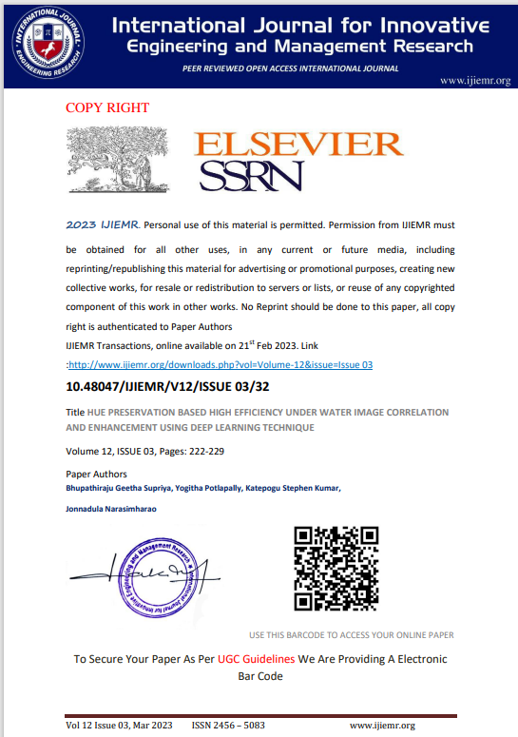
PAPER PUBLICATION

Slide 27
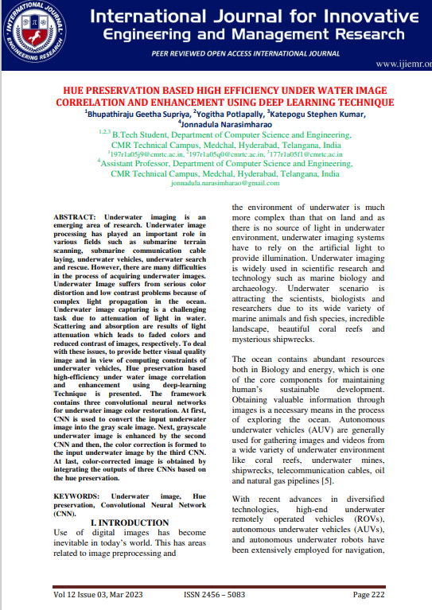

Slide 28
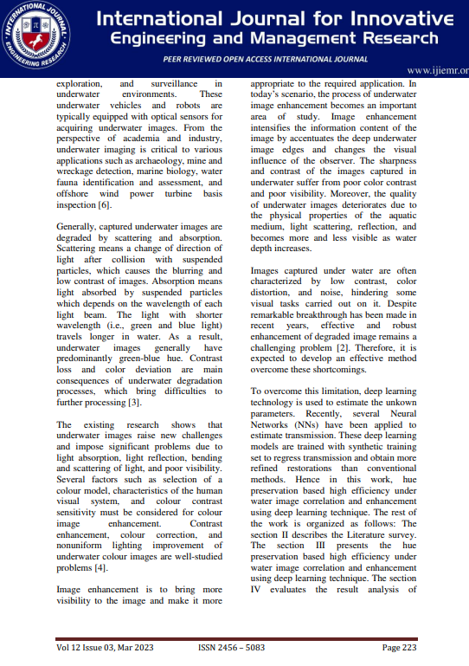

Slide 29
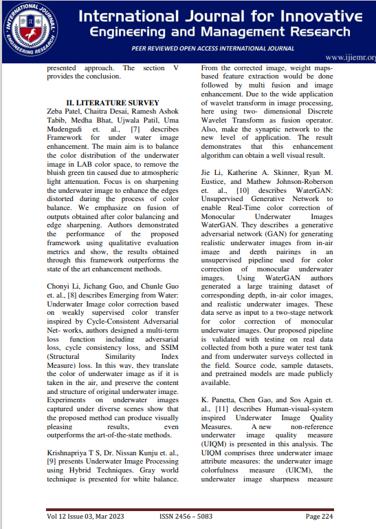

Slide 30
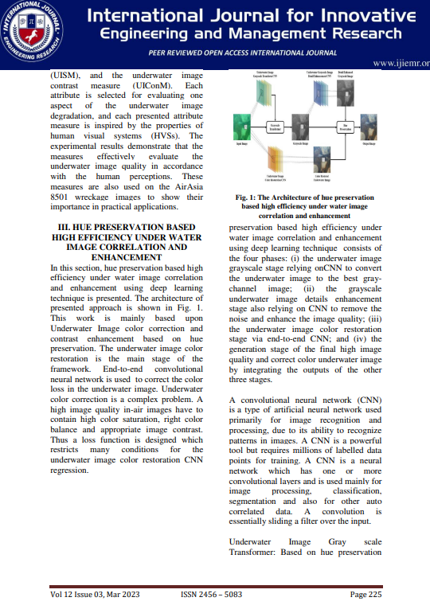

Slide 31
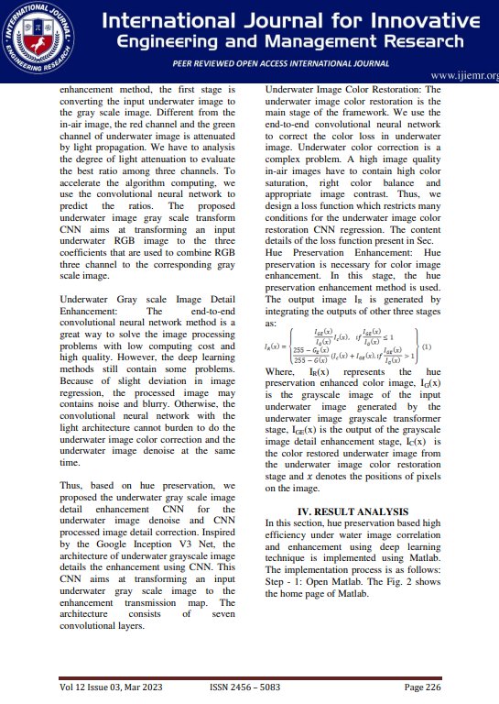

Slide 32
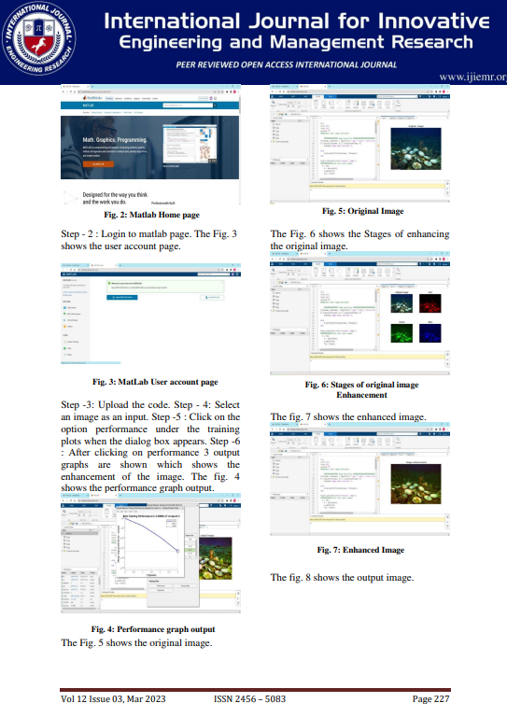

Slide 33
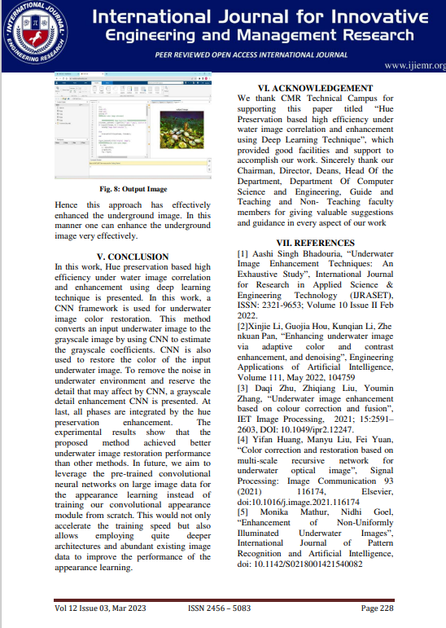

Slide 34
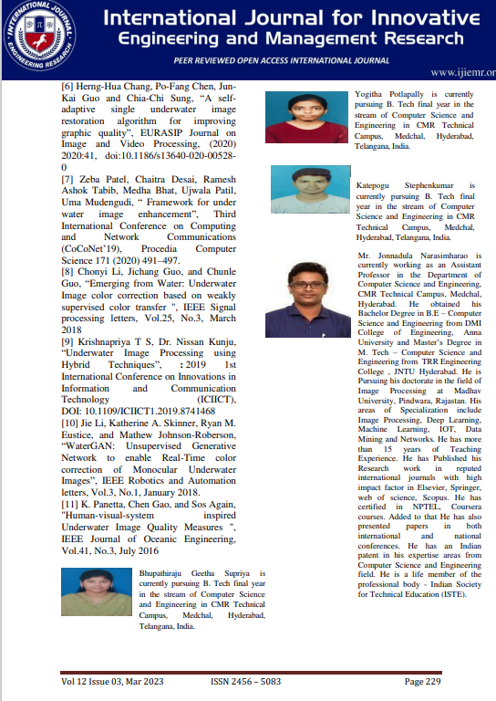

Slide 35
THANK YOU

